Slide 1

Mid-term Presentation: Credit Card Default Prediction
Group G:
Jiyoung You, Anoop Remanan Syamala, Steven Wong, Kenneth Wu

Slide 2
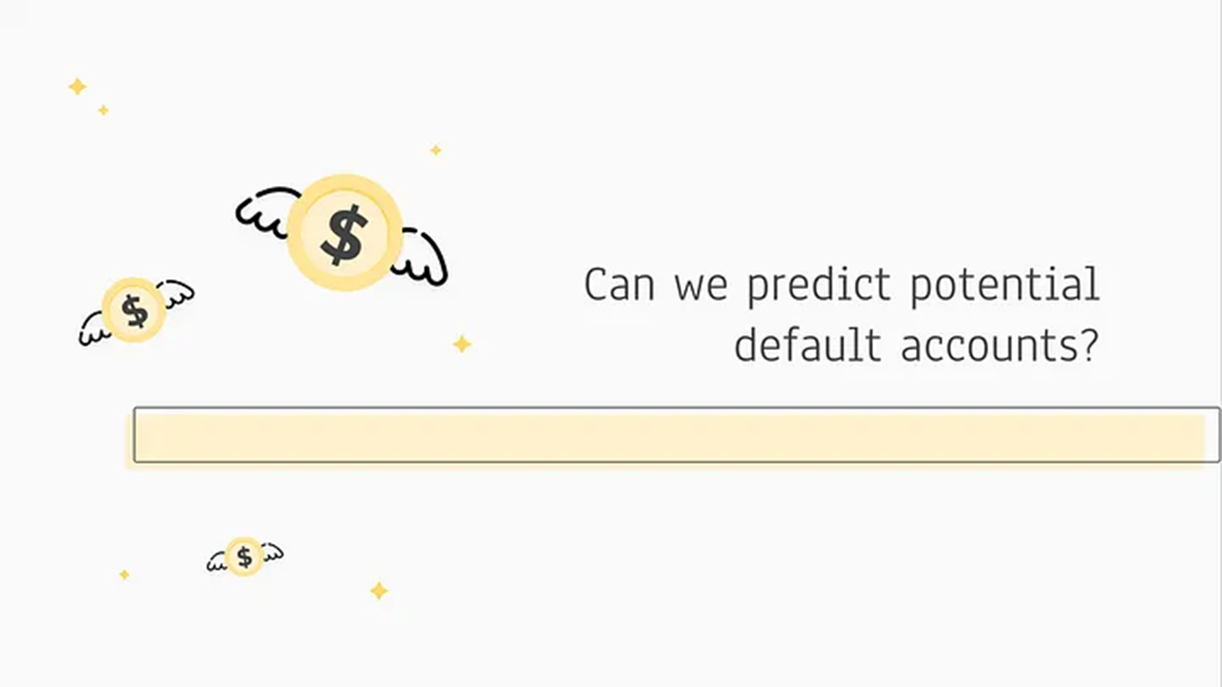
[1] Target
Problem: Credit Card Default Prediction
Field: Business

Slide 3
Approach
Data Collection
Data Exploring
Data Cleaning
Data Modeling

Slide 4
[2] Dataset
Data Collection:
Credit card clients in Taiwan
30,000 observations
24 features - Multivariate

Slide 5
Attribute Information:
a binary variable, default
X2: Gender (1 = male; 2 = female).
X3: Education (1 = graduate school; 2 = university; 3 = high school; 4 = others).
X4: Marital status (1 = married; 2 = single; 3 = others).
X5: Age (year).
X6 - X11: History of past payment.
X12-X17: Amount of bill statement (NT dollar).
X18-X23: Amount of previous payment (NT dollar).
Notes:
X12 = amount of bill statement in September, 2005; X13 = amount of bill statement in August, 2005; . . .; X17 = amount of bill statement in April, 2005.
X18 = amount paid in September, 2005; X19 = amount paid in August, 2005; . . .;X23 = amount paid in April, 200

Slide 6
Target Variable
default.payment.next.month
For next month, will the credit card client…
DEFAULT
NOT DEFAULT
vs.

Slide 7
[3] Packages and Tools
1.sklearn.preprocessing
PolynomialFeatures for regression prediction
2. sklearn.metrics
Mean Squared Error
R2 score
3. matplotlib.pyplot for graph
4. Random Forest Classifier
5. Logistics Regression vs. Ridge Classifier
fit score
6. from scipy.stats import binom_test
p-value test

Slide 8
[4] System Structure and Modules
Exploratory Data Analysis
Check the shape of the dataset
Check for missing values or outliers
Verify the data types for each column
Explore the relationship between our categorical variables: limit_bal, sex, education, marriage, and age
2. Modules: more details in next section

Slide 9
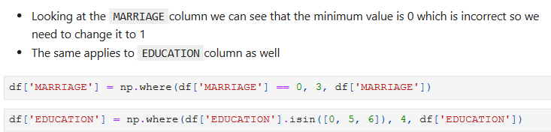
[5] Analysis and Prediction
Data Cleaning

Slide 10
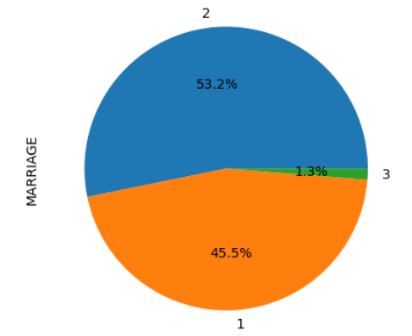
[5] Analysis and Prediction
2. Proportions for Marriage status data
marriage_counts = df['MARRIAGE'].value_counts()
marriage_props = marriage_counts / len(df) * 100
marriage_counts.plot(kind='pie',autopct='%0.01f%%', ylabel='MARRIAGE')

Slide 11
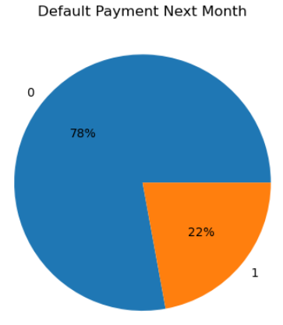
[5] Analysis and Prediction
3. Prediction for Default Payment next month
default_counts = pd.value_counts
(df['default.payment.next.month']) default_percentages
= default_counts / len(df) * 100
We can infer from this that 22.12% of people default every month which can set as the base line during the data modeling stage

Slide 12
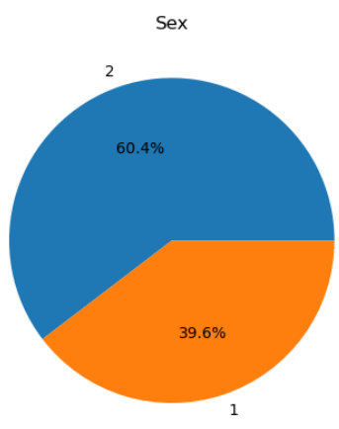
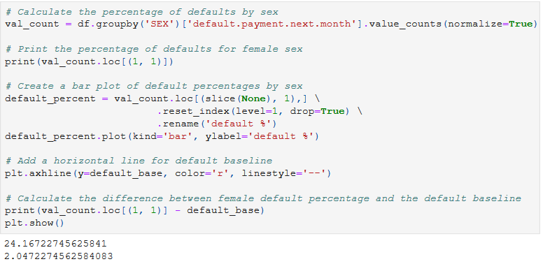
[5] Analysis and Prediction
4. Proportions by Gender data
5. Calculate expected default by group

Slide 13
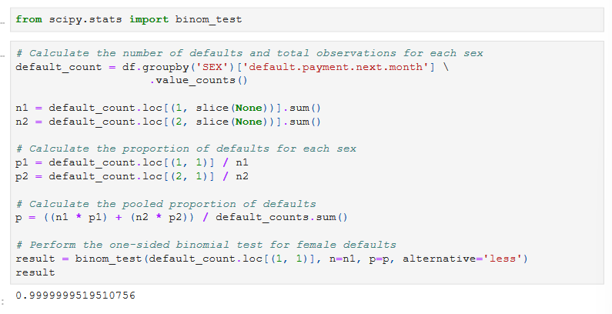
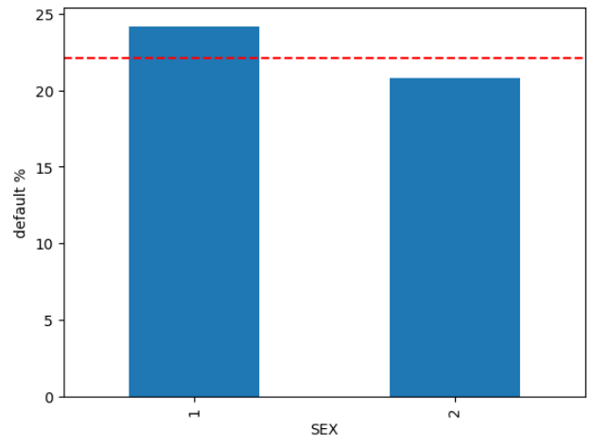
[5] Analysis and Prediction
6. p-value test
p-value less than 0.05 indicates that we can reject the null hypothesis and men are more likely to default than women

Slide 14
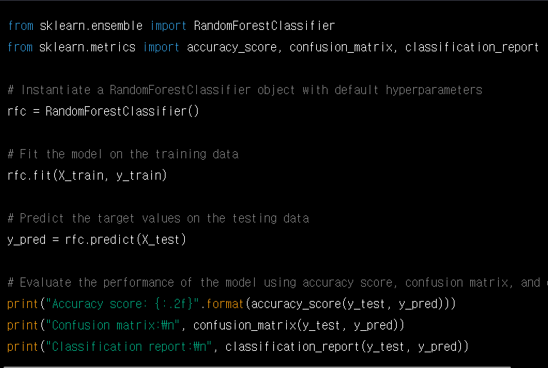
[5] Analysis and Prediction
7. Random Forest Classifier
Building a set of decision trees on randomly sampled subsets of the training data and features
Then, aggregating the individual predictions of each tree to make a final prediction

Slide 15
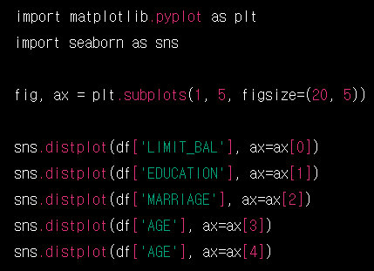
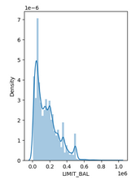
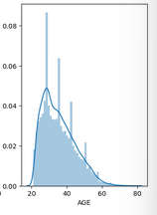
[5] Analysis and Prediction
8. Distribution plot: sns.distplot()

Slide 16
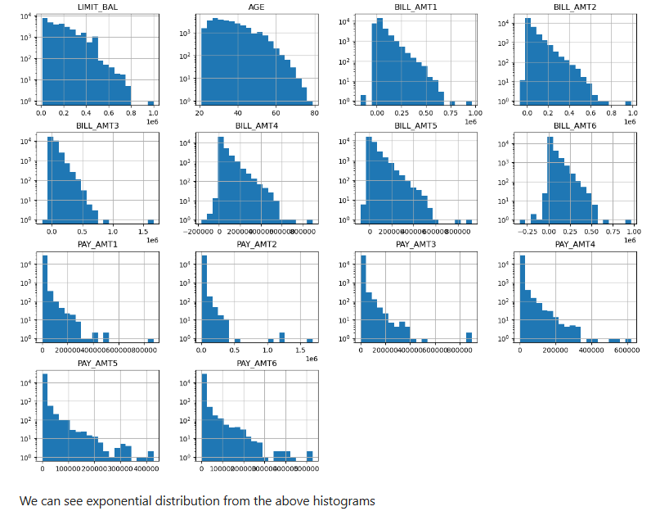
[5] Analysis and Prediction
9. Visualizing the distribution: fig.gca()

Slide 17
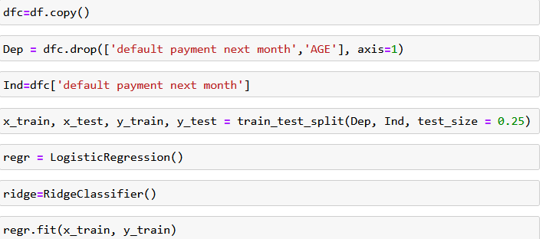
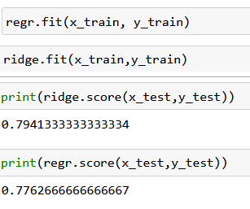
[5] Analysis and Prediction
10. Fitting a Ridge regression model to a training dataset.
Linear regression that uses L2 regularization to prevent overfitting and improve the generalization performance of the model.
Compare Logistics Regression with Ridge Classifier

Slide 18
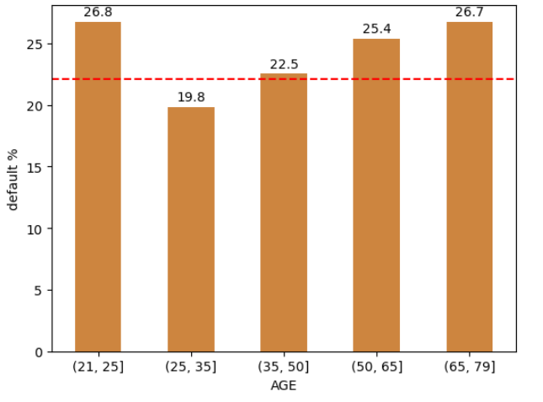
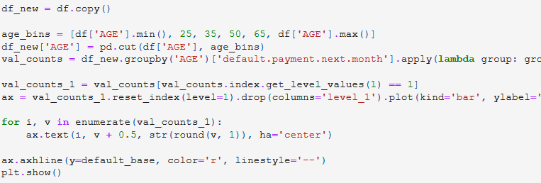
[5] Analysis and Prediction
11. Group the data by the combination of the default payment status: groupby()
a visual comparison of defaulting rates across different demographic variables, providing insights into potential patterns or factors that may influence a customer's likelihood to default.
From this we can infer than the age group from 25 to 35 are less likely to default, with 21 to 25 with the most likely default group probably because most of them could be students

Slide 19
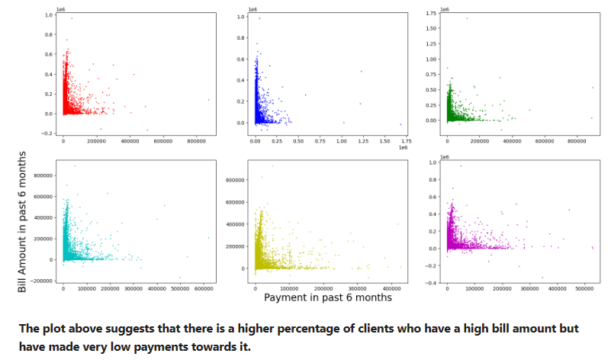
[5] Analysis and Prediction
12. Check past 6 months bill affect the payment default next month
Subplots() and scatter() – scatter plot

Slide 20
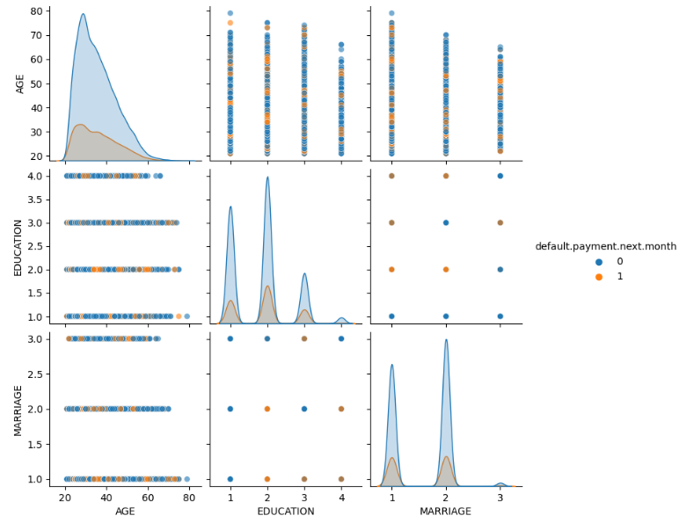
[5] Analysis and Prediction
13. Pair plot of 'AGE', 'EDUCATION', and 'MARRIAGE’
Exploring the relationships between these variables and how they may relate to the likelihood of defaulting on a payment in the next month.

Slide 21
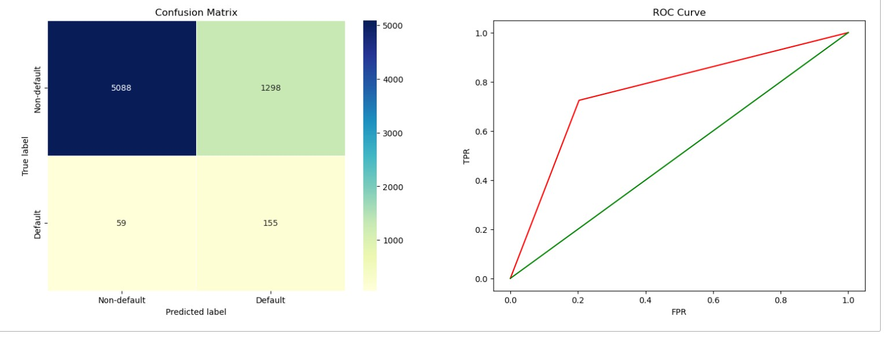
[5] Analysis and Prediction
14. Confusion Matrix for Binary Classification Model:
confusion_matrix = confusion_matrix(test_pred, y_test)
fpr, tpr, thresholds = roc_curve(test_pred, y_test)

Slide 22
[5] Analysis and Prediction
15. Future works
The dataset is highly imbalanced so we need to do either random over sampling or under sampling
Feature Engineering.
Cross validation and Hyperparameter tuning
Other ML models such as KNN, Adaboost, Xgboost, DT, SVM, Neural networks

Slide 23
[6] Expected Result
Analyze the data pattern
01
Predict the potential default payment of credit card by category
02
Check the statistical significance (p-value) of regression prediction
03
Test fitness of Machine Learning Methodologies
04

Slide 24
[7] Schedule
4/11 Mid-term presentation
4/25 Group Meeting – Research Methodology Discussion
5/9 Group Meeting – Share Results and Feedback
5/16 Group Meeting – Updated Results and Discussion
5/23 Group Meeting - Finalize
6/6 Final presentation

Slide 25

[8] Teamwork Assignments
Data Modeling: Anoop, Kenneth
Data Exploring: Steven, Ji Young
Data Collecting: Anoop
Analysis Methodology: Kenneth, Steven
Project Management: Ji Young

Slide 26
[9] Pre-completed Item
Data Collection
Data Analysis
Random Forest Classifier
Compare Logistics Regression with Ridge Classifier
Data Visualization

Slide 27


